Slide 1
Sustainable Seamount Bottom trawling
August 2022

Slide 2
Introduction
Sealord presents this paper as part of its sustainability strategy and in response to the Government-led industry review into seamount trawling and a long-running campaign by eNGOs.
We would like the public to understand Sealord’s commitment to sustainable fishing practices, particularly on ecologically important sites such as seamounts.
40% of seafood caught each year in New Zealand’s Exclusive Economic Zone (EEZ) comes from bottom trawling. Kiwis’ fish supply, and exports, depends on this practice.
Fishing can and must be sustainable for every location and method, so Sealord proposes to close 89% of seamounts to bottom trawling in New Zealand’s EEZ. Fishing on 11% of seamounts provides enough catch to meet local and global demand for New Zealand fish species that congregate over seamounts.

Slide 3
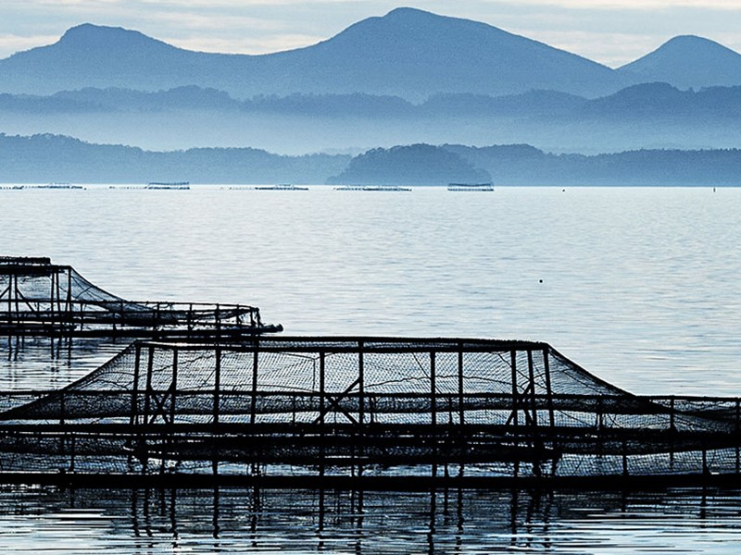
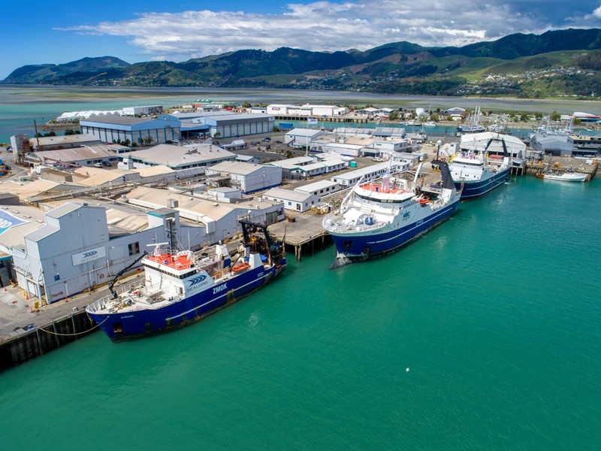
Summary
New Zealand’s deep-sea fisheries produce 700 million servings of fresh seafood every year.
This is largely due to the significant number of seamounts in the volcanically active Pacific Ocean.
Seamounts are internationally defined as underwater topographical features rising 1,000m or more above the seabed.
Seamounts are an essential part of New Zealand’s marine ecosystem, forming one of the most fertile habitats for marine life and our most popular deep-water fish species.
These fish are caught by trawling established tracks on the seabed, which has proven to be the most effective and efficient way of sustainably fishing within our quota.

Slide 4
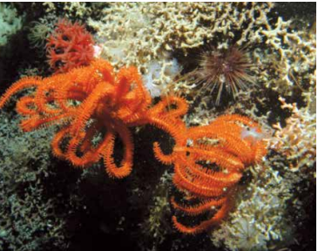
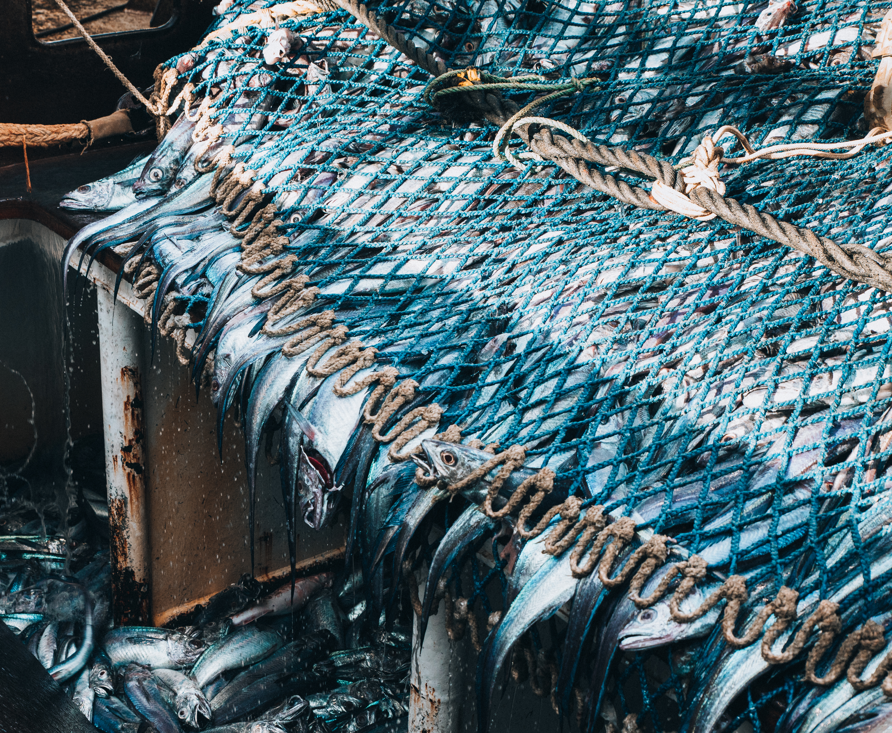
Concerns about the effect of bottom trawling have been raised by different groups.
In 2020, Hon David Parker and Eugenie Sage received a public petition against bottom trawling on seamounts co-signed by Greenpeace and other eNGOs.
These groups argued that because seamounts provide irreplaceable habitats and nurseries, bottom trawling must be banned to prevent habitat loss.
While the first trawl does damage parts of seamounts, subsequent trawls do not cause as much damage because they follow existing tracks.
Currently, many untouched seamounts remain legally accessible to trawlers, and fishing on these sites could result in damage to corals and sponges that would take years to recover.
At present, only 15 seamounts in New Zealand’s EEZ have ever been bottom trawled.

Slide 5
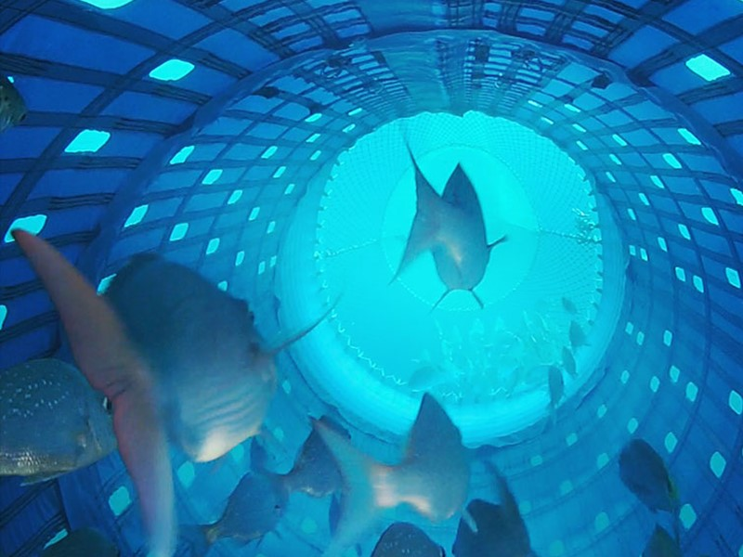
Policy Proposal
To protect the biodiversity of the ecosystems that exist on seamounts beyond doubt, Sealord proposes to close 89% of seamounts to bottom trawling in New Zealand’s EEZ.
Fishing on 11% of seamounts provides enough catch to meet local and global demand for New Zealand fish species.
It expands protections to Benthic Protection Areas (BPAs) and Seamount Closure Areas (SCAs) for 127 of the 142 known seamounts in NZ’s EEZ.
This represents every seamount that has never been trawled before.

Slide 6
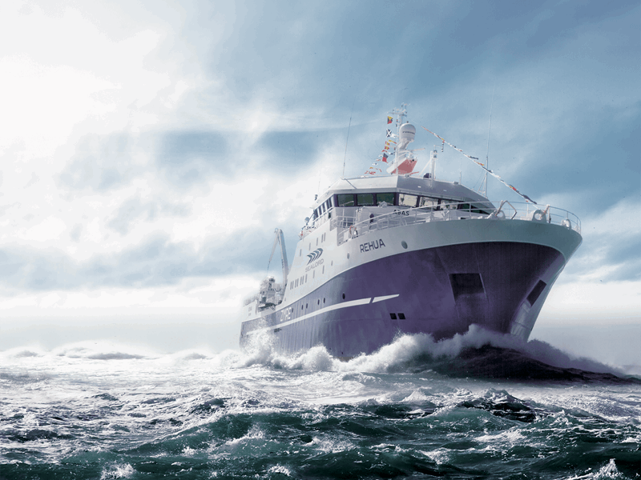
Situation
In 1982, the United Nations established Exclusive Economic Zones all over the world.
This granted New Zealand special rights over the use of marine resources within 200 miles of its coastline, including seamounts.
New Zealand introduced the world leading Quota Management System (QMS) in 1986 to ensure sustainable fishing.
This operated alongside the Wildlife Act 1953 and the Marine Mammals Protection Act 1978.
There have been no targeted conservation provisions for seamounts until recently.

Slide 7
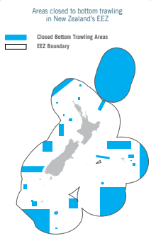
In 2001, Seamount Closure Areas (SCAs) prohibited trawling on and above 17 seamounts to protect benthic biodiversity.
In 2007, Benthic Protection Areas (BPAs) banned dredging and bottom trawling in 32% of the EEZ.
As a result, 71 seamounts within the EEZ are entirely closed to bottom trawling.
In the following 15 years, 56 unprotected seamounts have remained untouched. No ‘exploratory trawling’ has taken place on seamounts.
This is because commercial bottom trawling vessels have consistently and sustainably met their total allowable catch whilst returning to existing trawl tracks.

Slide 8
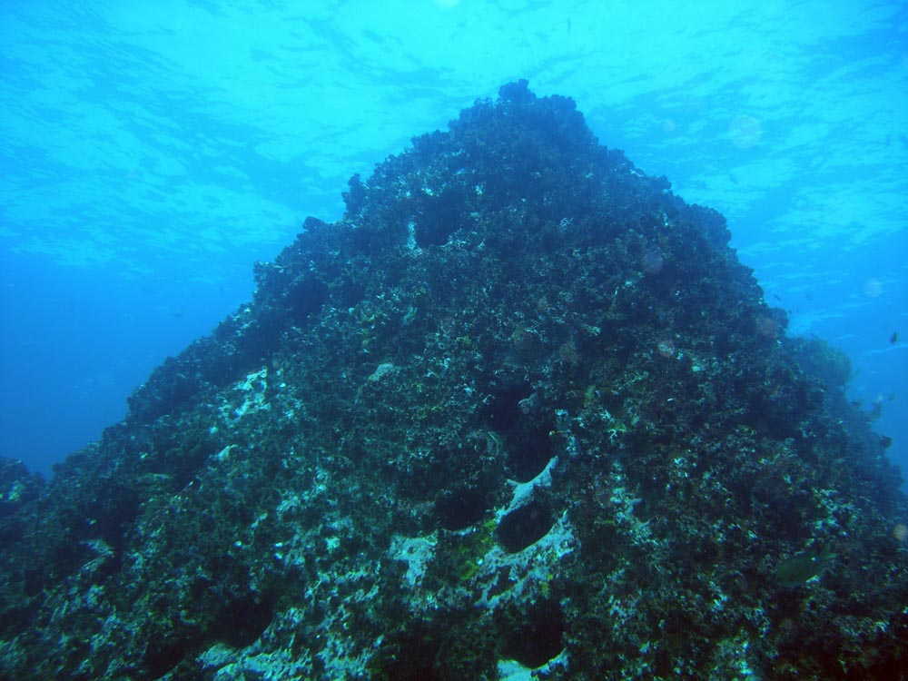
Seamounts
Seamounts are one of the most common marine ecosystems, with more than 100,000 internationally.
International consensus defines seamounts as underwater topographical features rising 1,000m or more above the seabed. Smaller features are referred to as hills and knolls.
These features provide rocky substrate for the attachment of sessile benthic organisms, colonies of which create biogenic habitats for other species.
Every seamount is different, with levels of biodiversity influenced by the physical oceanography, depth and temperature of water, underwater currents and habitat suitability.

Slide 9
Seamount benthic communities
In New Zealand, the fishery species that congregate above seamounts are orange roughy, oreos (smooth and black), cardinalfish and alfonsino.
Their habitat is characterized as bentho-pelagic – they live in the water column but tend to stay near the bottom.
When avoiding predation or fishing, they dive toward the sea floor – they can only be caught by nets that touch the bottom.
Notably, these species are not reliant on the seamount benthic ecosystem for food, nursery, refuge or spawning.
No species commercially fished on New Zealand seamounts have a direct trophic relationship with species that are associated with the seamount benthic communities.

Slide 10
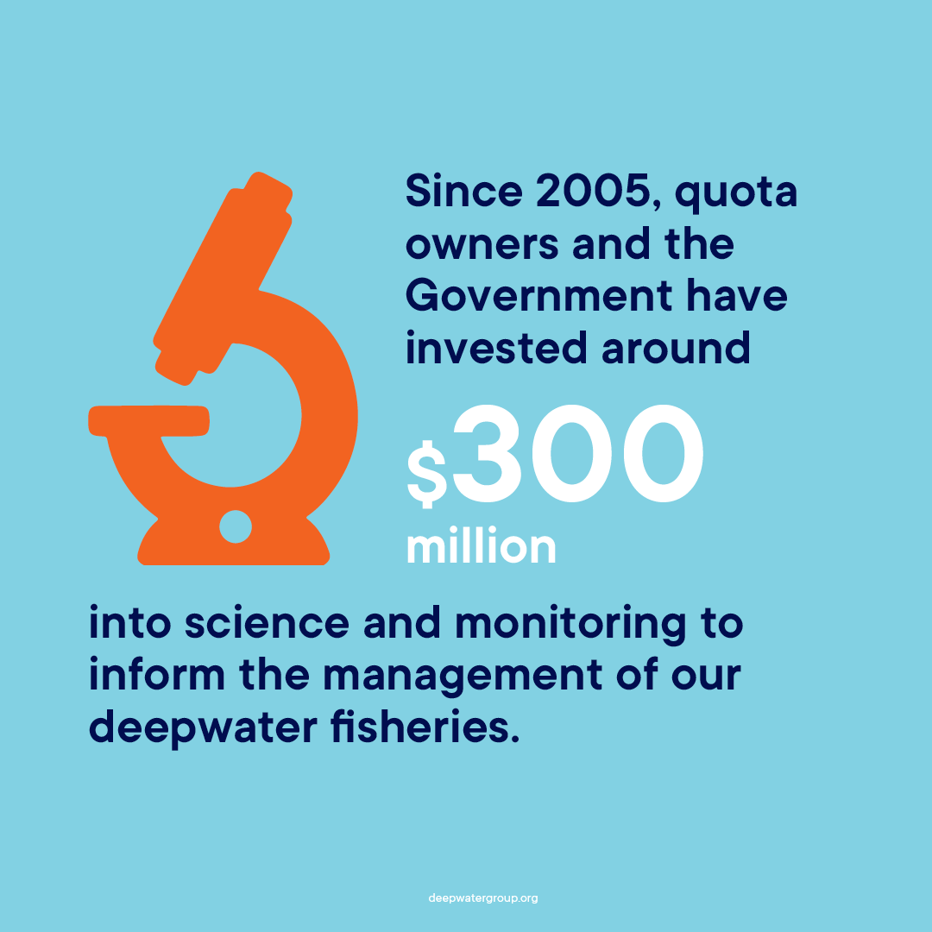
Key Myths
Seamount fisheries target deep-water species that are long lived, slow growing, with low fecundity:
This is not specific to fish caught on seamounts. It matters for all deep-water fisheries to ensure that fish populations are not overexploited.
In New Zealand, the QMS and stock assessment accounts for these concerns.
For fisheries management, fishing on seamounts must be stopped:
New Zealand has a mature fishing industry that is not expanding, with high-level environmental research and fisheries management. It is focused on ensuring long-term sustainable commercial extraction.
This would only be true if exploratory fishing was expanding, with little commercial constraints, in New Zealand.
While seamounts have a higher benthic abundance and species richness, they are easier to find, describe and manage than comparable areas on the flats. This is essential for measured, sustainable fishing for the future.

Slide 11
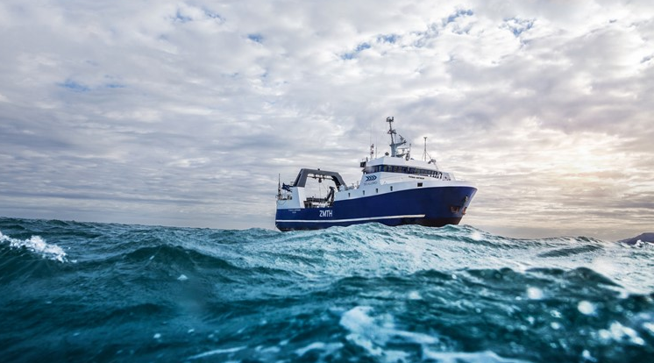
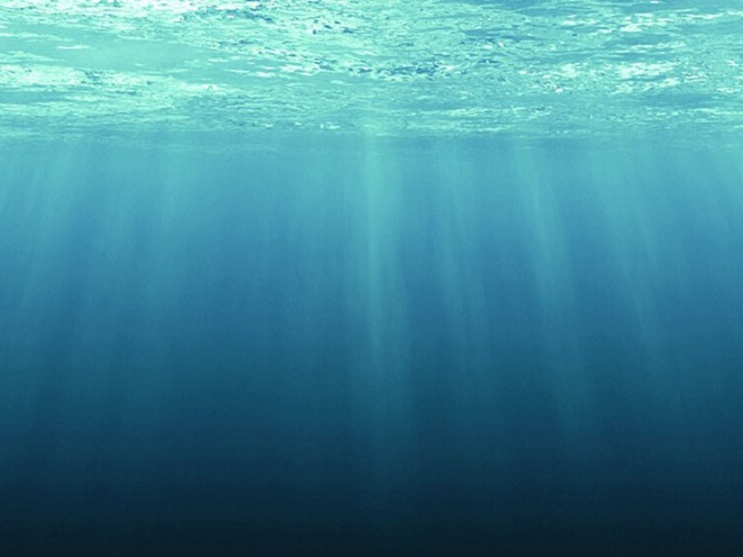
Conclusion
Sealord’s proposal to extend conservation protections to 89% of seamounts in New Zealand’s EEZ is designed to balance the importance of conservation and feeding New Zealand and the world.
While trawled seamounts will remain as they are now, any closed seamounts that have been impacted will regenerate over time. Untouched seamounts will be preserved into perpetuity.
This proposal has a negligible effect on the operations of Sealord.
In short, fishing on 11% of seamounts provides enough catch to meet New Zealand and global demand for New Zealand fish species that congregate over seamounts whilst providing conservation for these important ecosystems.

Slide 12
Questions?

